Slide 1

Capacitor Circuits
Sikandar Khan

Slide 2
Objectives: After completing this module, you should be able to:
Calculate the equivalent capacitance of a number of capacitors connected in series or in parallel.
Determine the charge and voltage across any chosen capacitor in a network when given capacitances and the externally applied potential difference.

Slide 3

Electrical Circuit Symbols
Electrical circuits often contain two or more capacitors grouped together and attached to an energy source, such as a battery.
The following symbols are often used:
Ground
Battery
Capacitor
+
-
+
-
+ - + -
+
-
- + - + -

Slide 4
Series Circuits
Capacitors or other devices connected along a single path are said to be connected in series. See circuit below:
Series connection of capacitors. “+ to – to + …”
+
-
+
-
+
-
+
-
+
-
+
-
C₁
C₃
C₂
Battery
Charge inside dots is induced.

Slide 5
Charge on Capacitors in Series
Since inside charge is only induced, the charge on each capacitor is the same.
Q₁
Q₂
Q₃
Charge is same: series connection of capacitors.
+
-
+
-
+
-
+
-
+
-
+
-
C₁
C₃
C₂
Battery
Q = Q₁ = Q₂ =Q₃

Slide 6
Voltage on Capacitors in Series
Since the potential difference between points A and B is independent of path, the battery voltage V must equal the sum of the voltages across each capacitor.
V₁
V₂
V₃
Total voltage V Series connection Sum of voltages
+
-
+
-
+
-
+
-
+
-
+
-
C₁
C₃
C₂
•
•
A
Battery
B
V = V₁ + V₂ + V₃

Slide 7
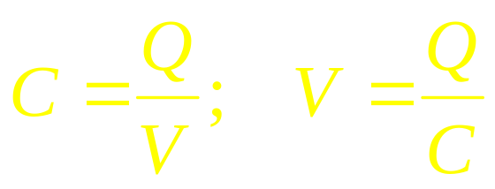
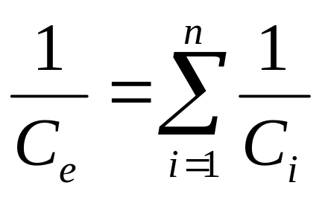
Equivalent Capacitance: Series
V₁
V₂
V₃
+
-
+
-
+
-
+
-
+
-
+
-
C₁
C₂
C₃
V = V₁ + V₂ + V₃
Q₁= Q₂ = Q₃
Equivalent C_{e} for capacitors in series:

Slide 8
Example 1. Find the equivalent capacitance of the three capacitors connected in series with a 24-V battery.
C₁
C₂
C₃
C_{e} for series:
+
-
+
-
+
-
+
-
+
-
+
-
2 μF
4 μF
6 μF
24 V
C_{e} = 1.09 μF

Slide 9
Example 1 (Cont.): The equivalent circuit can be shown as follows with single C_{e.}
C₁
C₂
C₃
C_{e}
+
-
+
-
+
-
+
-
+
-
+
-
2 μF
4 μF
6 μF
1.09 μF
24 V
C_{e} = 1.09 μF
24 V
Note that the equivalent capacitance C_{e} for capacitors in series is always less than the least in the circuit. (1.09 μF < 2 μF)

Slide 10
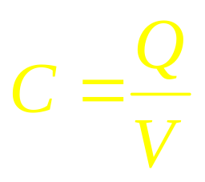

Example 1 (Cont.): What is the total charge and the charge on each capacitor?
C₁
C₂
C₃
C_{e}
C_{e} = 1.09 μF
+
-
+
-
+
-
+
-
+
-
+
-
2 μF
4 μF
6 μF
1.09 μF
24 V
24 V
Q_{T} = 26.2 μC
Q_{T} = C_{e}V = (1.09 μF)(24 V);
For series circuits: Q_{T} = Q₁ = Q₂ = Q₃
Q₁ = Q₂ = Q₃ = 26.2 μC

Slide 11




Example 1 (Cont.): What is the voltage across each capacitor?
C₁
C₂
C₃
+
-
+
-
+
-
+
-
+
-
+
-
2 μF
4 μF
6 μF
24 V
V_{T} = 24 V
Note: V_{T} = 13.1 V + 6.55 V + 4.37 V = 24.0 V

Slide 12
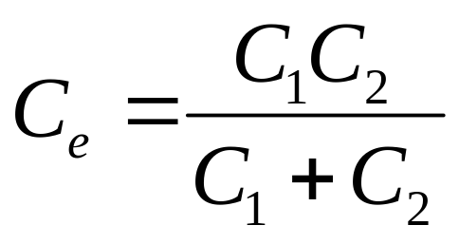
Short Cut: Two Series Capacitors
The equivalent capacitance C_{e} for two series capacitors is the product divided by the sum.
Example:
C₁
C₂
+
-
+
-
+
-
+
-
C_{e} = 2 μF
3 μF
6 μF

Slide 13
Parallel Circuits
Capacitors which are all connected to the same source of potential are said to be connected in parallel. See below:
Parallel capacitors: “+ to +; - to -”
Voltages: V_{T} = V₁ = V₂ = V₃
C₁
C₂
C₃
+
+
+
+
+
+
Charges: Q_{T} = Q₁ + Q₂ + Q₃
-
-
-
-
-
-

Slide 14
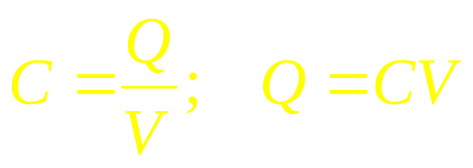
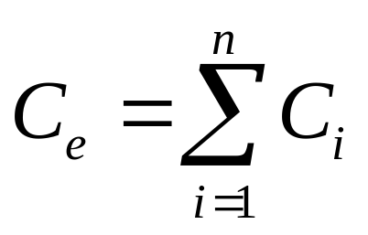
Equivalent Capacitance: Parallel
Parallel capacitors in Parallel:
C₁
C₂
C₃
Q = Q₁ + Q₂ + Q₃
+
+
+
+
+
+
-
-
-
-
-
-
Equal Voltages: CV = C₁V₁ + C₂V₂ + C₃V₃
Equivalent C_{e} for capacitors in parallel:
C_{e} = C₁ + C₂ + C₃

Slide 15
Example 2. Find the equivalent capacitance of the three capacitors connected in parallel with a 24-V battery.
V_{T} = V₁ = V₂ = V₃
C_{e} for parallel:
Q = Q₁ + Q₂ + Q₃
24 V
C₁
C₂
C₃
C_{e} = (2 + 4 + 6) μF
2 μF
4 μF
6 μF
C_{e} = 12 μF
Note that the equivalent capacitance C_{e} for capacitors in parallel is always greater than the largest in the circuit. (12 μF > 6 μF)

Slide 16
Example 2 (Cont.) Find the total charge Q_{T} and charge across each capacitor.
Q = Q₁ + Q₂ + Q₃
C_{e} = 12 μF
24 V
C₁
C₂
C₃
V₁ = V₂ = V₃ = 24 V
2 μF
4 μF
6 μF
Q_{T} = C_{e}V
Q₁ = (2 μF)(24 V) = 48 μC
Q_{T} = (12 μF)(24 V)
Q₁ = (4 μF)(24 V) = 96 μC
Q_{T} = 288 μC
Q₁ = (6 μF)(24 V) = 144 μC

Slide 17
Example 3. Find the equivalent capacitance of the circuit drawn below.
24 V
C₁
C₂
3 μF
C_{e} = 4 μF + 2 μF
4 μF
C₃
6 μF
C_{e} = 6 μF
24 V
C₁
24 V
C_{3,6}
2 μF
C_{e}
6 μF
4 μF

Slide 18
Example 3 (Cont.) Find the total charge Q_{T}.
C_{e} = 6 μF
24 V
C₁
C₂
3 μF
Q = CV = (6 μF)(24 V)
4 μF
C₃
6 μF
Q_{T} = 144 μC
24 V
C₁
24 V
C_{3,6}
2 μF
C_{e}
6 μF
4 μF

Slide 19
Summary: Series Circuits
Q = Q₁ = Q₂ = Q₃
V = V₁ + V₂ + V₃
For two capacitors at a time:

Slide 20
Summary: Parallel Circuits
Q = Q₁ + Q₂ + Q₃
V = V₁ = V₂ =V₃
For complex circuits, reduce the circuit in steps using the rules for both series and parallel connections until you are able to solve problem.

Slide 21


CONCLUSION:
Capacitor Circuits

